Slide 1

Medical Diagnosis App
AI-Based Health Assessment Using Streamlit and Machine Learning
Name: SHAHNAZ BEGAM SHAIK
Email Id: shahshaik2000@gmail.com
Guide: saomya chaudary

Slide 2
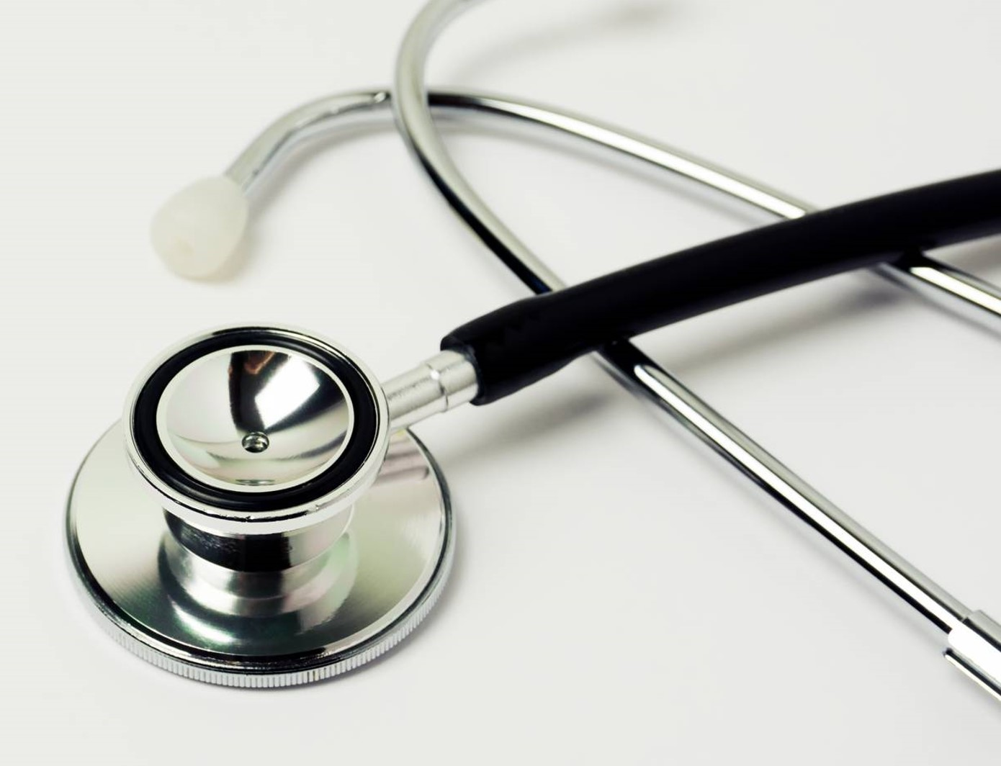
Agenda
Problem Statement
Proposed Solution
Software Requirement
System Architecture
Video of the Project
Future Scope
Conclusion

Slide 3
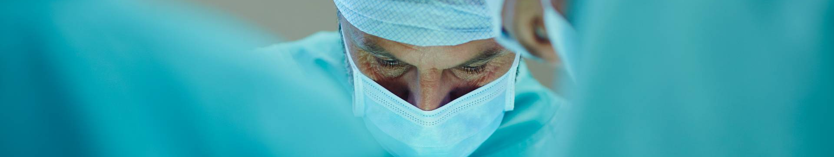
Problem Statement
Access to timely and accurate medical diagnosis remains a significant challenge, especially in remote areas where healthcare facilities are limited.
Traditional diagnostic methods often require multiple hospital visits, leading to delays and increased costs. Many individuals rely on self-diagnosis, which can result in misinformation and potential health risks.
Additionally, early symptoms of critical diseases like heart disease, diabetes, and cancer often go unnoticed due to a lack of awareness.
There is a growing need for a digital solution that can provide quick, AI + ML -powered preliminary diagnoses, helping individuals make informed decisions about their health before seeking professional medical attention.

Slide 4
Challenges
Limited Access to Healthcare: Many regions lack sufficient medical professionals and facilities.
High Cost of Diagnosis: Traditional medical tests and consultations can be expensive.
Time Constraints: Long wait times for appointments and test results delay early detection.
Misdiagnosis Risks: Self-diagnosis or delayed diagnosis can lead to severe health consequences.
Lack of Awareness: Many people do not recognize the early symptoms of serious illnesses.

Slide 5
Proposed Solution
To address the challenges in healthcare accessibility and early diagnosis, we propose an AI-powered Medical Diagnosis App. This application leverages Machine Learning and Large Language Model to analyze user-provided symptoms and Gen AI to medical reports, offering preliminary diagnoses and treatment recommendations.
Key Features of the Solution
AI-Based Symptom Analysis:
- Users can enter symptoms manually or upload a PDF medical report for automated analysis.
- The app processes the input and predicts potential medical conditions.
- Prescription & Recommendations:
Based on the diagnosis, the system provides basic treatment suggestions and lifestyle recommendations.

Slide 6
Proposed Solution
2. Disease-Specific Diagnosis Modules:
- Specialized ML models for heart disease, breast cancer, diabetes, kidney disease, and liver disease.
3. User-Friendly Interface with Streamlit:
- A simple and interactive interface for non-technical users.
- Accessible from any device with an internet connection.
4. Fast & Cost-Effective:
- Reduces the need for multiple hospital visits by offering instant preliminary diagnosis.
This solution enhances early disease detection, promotes health awareness, and empowers individuals to seek medical attention at the right time.

Slide 7
Software Requirement
Frontend
Programming Language: Python
Libraries: Streamlit
Backend
Programming Language: Python
Libraries: PyPDF2, pandas, ollama, pickle, numpy, matplotlib, seaborn, sklearn
Machine Learning Models:
Disease prediction models for heart disease, breast cancer, diabetes, kidney disease, and liver disease.
Logistic Regression, KNearestNeighbors, SVM, Decision Tree, Random Forest, Gradient Boosting, XGBoost

Slide 8
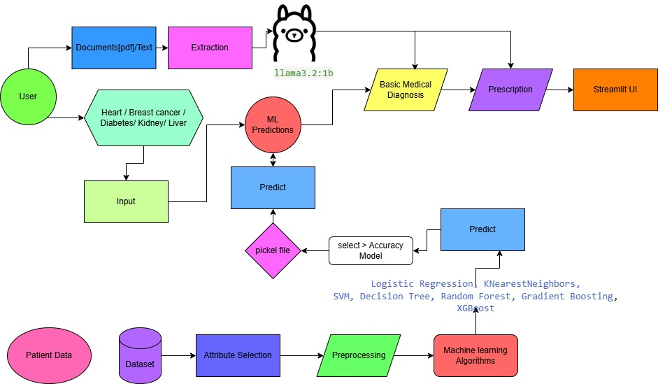
System Architecture

Slide 9
Video of the Project
Uploaded Video to Google Drive
https://drive.google.com/file/d/1ThssS7_vAj5vyIeSLdx-Ee9R7t5Tk5l0/view?usp=sharing

Slide 10
Future Scope
Expansion of Disease Categories: Adding more diseases for detection.
Integration with Wearable Devices: Syncing data from smartwatches and fitness trackers.
AI-Based Prescription Generator: More advanced recommendations based on medical history.
Cloud-Based Patient Reports: Secure storage for follow-ups.

Slide 11

Conclusion
A cost-effective, AI-powered medical diagnosis tool.
Helps users get preliminary diagnosis and treatment guidance quickly.
Future updates will enhance accuracy and usability.
Encourages proactive healthcare management.

Slide 12

Thank you
Shahnaz begam Shaik
shahshaik2000@gmail.com

